Slide 1
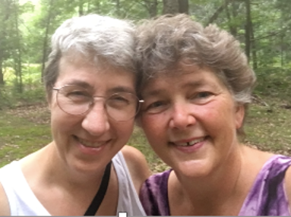


Rissa Moore and Linda Smith Koehler
Music available at
womenwithwings.org
lindakoehler29@gmail.com
YouTube channel (Linda Koehler)
https://www.youtube.com/channel/UCLGANnUw58dLC6W70MRit5A/videos

Slide 2

I wanna be like RBG,
where I listen to my wisdom and follow my calling.
I wanna be like RBG
where I use my life
to build a better world for all
By Linda Smith Koehler ©2020

Slide 3
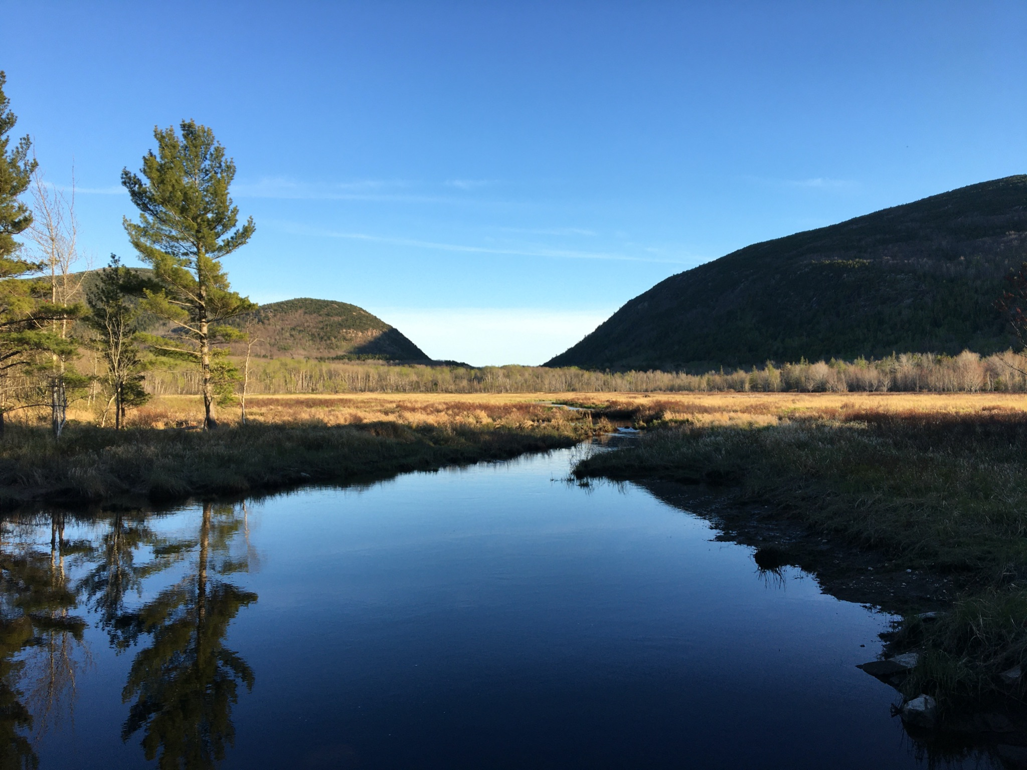
Wherever you are, you’re rooted in holy ground.
Whenever you are, you’re living in sacred times.
Whomever you’re with,
you’re in the presence of the divine,
So whatever you do, keep that in mind.
Holy Ground by Linda Smith Koehler ©2002

